Slide 1
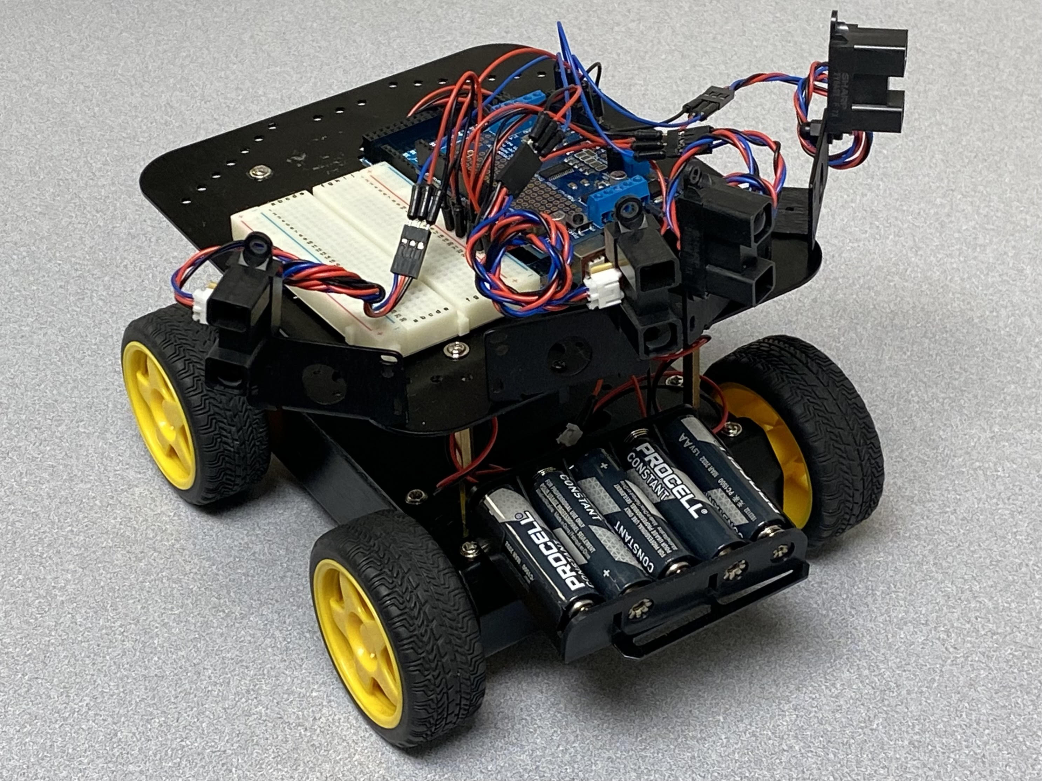
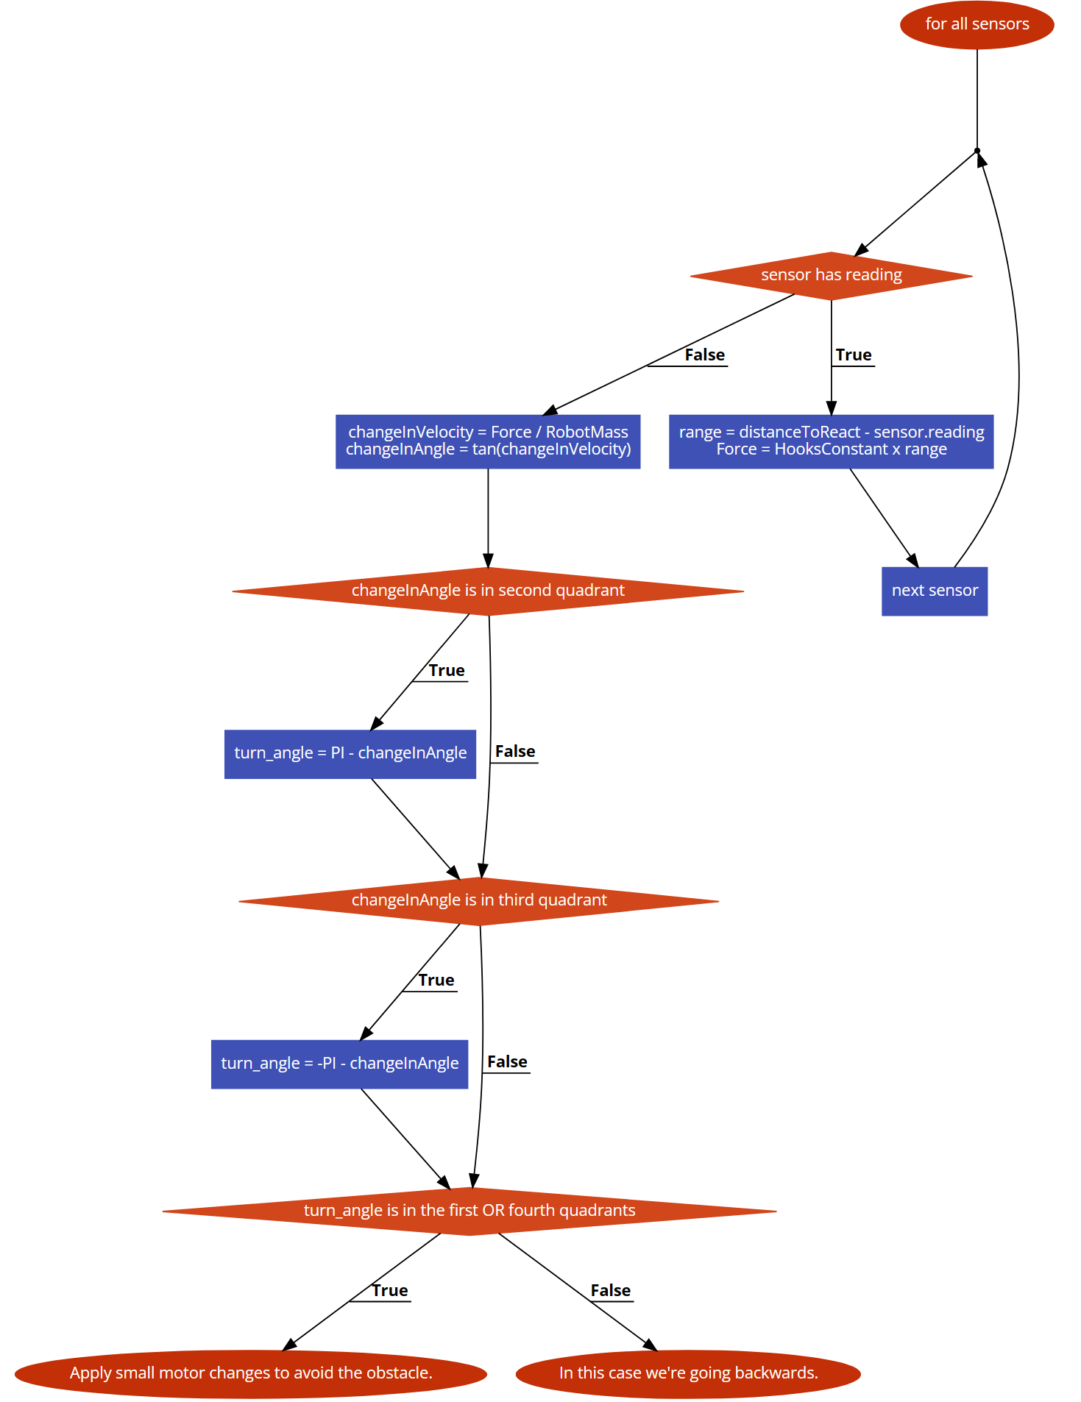
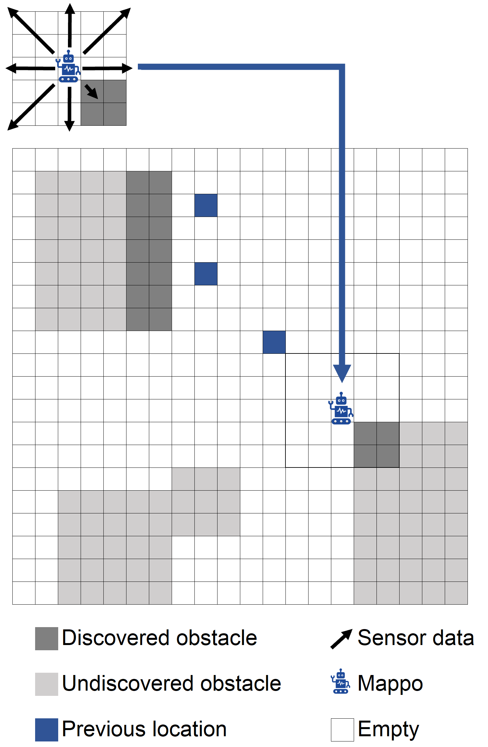
Mappo the Explorer
Eli Nutter, Jamal Mahdi – IUS Computer Science
Faculty Advisor: Suranga Hettiarachchi
Goal
The objective of this project is to build a prototype robot that can map its surrounding area. We use a comprehensive mapping algorithm in conjunction with an obstacle avoidance system. This combination of features allows the robot to traverse and map an area for obstacles .
Local area mapping
Mapping, especially without using GPS, is a difficult issue to solve. In essence, this is situational awareness and localization of one’s environment. Humans do this well, as they have vast swaths of sensor data, such as eyesight, hearing, smell, touch, and a directional memory. Meanwhile, our robot only has several infrared sensors.
We construct two grids: a local and a global grid. At each movement step, the robot marks the local grid with any obstacles that its sensors detect. At the end of the movement step, it maps this local grid to the global one as shown below.
Technical Description
This robot is a small mobile machine, using motor-driven wheels as it’s primary mobility source. IR sensors are attached to the front, sides, and back. This data is used for both obstacle avoidance and local area mapping.
Obstacle avoidance is using the “AP Lite” algorithm. It works by creating a virtual force that pushes the robot away from any nearby obstacles. This allows the robot to drive next to walls and turn away when approaching an object. Additionally, we customized the algorithm to move backwards when robot is stuck.
Local area mapping is implemented with a grid-based discovery algorithm. The robot moves to a point and then stores data about what is around it to a global grid. It chooses a direction to move and continues this process.
Mappo himself
Obstacle Avoidance
The obstacle avoidance algorithm works by producing virtual forces between the robot and obstacles, changing forces affects the robot’s velocity, thereby allowing robot to make necessary adjustments to distance to obstacles. This allows the robot to behave as a spring that remains in its equilibrium state.

